Slide 1

MoneyStream
Real-time currency exchange rates with partner-to-partner cash transfers

Slide 2
CONTENTS OF THIS TEMPLATE
You can delete this slide when you’re done editing the presentation
Fonts | To view this template correctly in PowerPoint, download and install the fonts we used
Used and alternative resources | An assortment of graphic resources that are suitable for use in this presentation
Thanks slide | You must keep it so that proper credits for our design are given
Colors | All the colors used in this presentation
Icons and infographic resources | These can be used in the template, and their size and color can be edited
Editable presentation theme | You can edit the master slides easily. For more info, click here
For more info: SLIDESGO | BLOG | FAQs
You can visit our sister projects: FREEPIK | FLATICON | STORYSET | WEPIK | VIDEVO

Slide 3
TABLE OF CONTENTS
01
04
02
05
03
06
OUR PRODUCT
BUSINESS PLAN
TEAM DESCRIPTION
MK& SALES STRATEGY
MARKET ANALYSIS
FINANCIAL PROJECTIONS

Slide 4
02
TEAM DESCRIPTION

Slide 5
MEET US
VISION
BARGAOANU BOGDAN
FORRAI DIANA
To create a seamless and transparent currency exchange platform that prioritizes both users and businesses by offering real-time rates, direct transactions, and powerful financial tools, ensuring efficiency, security, and mutual growth.
Description
Description

Slide 6
04
BUSINESS PLAN

Slide 7

EXECUTIVE SUMMARY
Our business plan outlines the strategy for MoneyStream, a fintech startup that provides real-time currency exchange, cash transactions, and market trend monitoring. Our mission is to streamline currency exchange by offering transparent rates, secure transactions, and direct partner negotiations.
The market analysis shows that there is a high demand for our services in the global financial and foreign exchange industry. We have identified key competitors, including traditional exchange bureaus and digital currency platforms, and believe we can differentiate ourselves through our unique selling propositions (USPs):

Slide 8
UNIQUE SELLING PROPOSITIONS
REAL-TIME RATES
REQUEST AND DELIVERY
Users can instantly compare exchange rates from multiple partners and locate the best deals via an interactive map.
Businesses can request cash from platform-enrolled partners, ensuring fast, secure, and efficient cash flow management.
MULTI-LOCATION
DATA VISUALIZATION
Partners can register multiple business locations, allowing them to manage exchange services across different areas seamlessly.
Partners enrolled gain access to real-time analytics through interactive charts and dashboards.

Slide 9
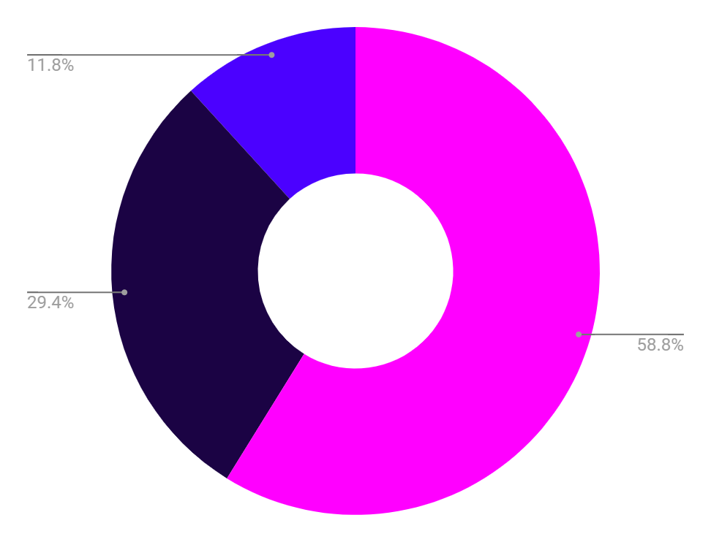
SELLING PLAN (1ST YEAR)
1ST TRIMESTER
2ND TRIMESTER
Beta launch, onboarding strategic partners (exchange offices, hotels, airports).
Digital marketing campaign (SEO, social media, Google Ads), customer onboarding.
3RD TRIMESTER
4TH TRIMESTER
Expansion of partnerships in key cities, feature optimization based on feedback.
Full-scale launch, integration with third-party financial applications, monetization through commissions and premium subscriptions.

Slide 10
BUDGET FOR THE 1ST YEAR
€50,000
€25,000
€10,000
Product development
Marketing
Support

Slide 11
BUSINESS PLAN TIMELINE
01
Research and planning
06
Scaling phase
07
Innovation phase
02
Start-up phase
05
Product expansion
08
Exit strategy planning
03
Growth phase
04
Partnership
09
Final phase

Slide 12
MARKET ANALYSIS
INDUSTRY OVERVIEW
TARGET MARKET
COMPETITIVE LANDSCAPE
Provide a brief overview of your industry, including its size and growth trends. Identify key players in the market and any regulatory or technological changes that could impact your business or company
Describe your target customer segment(s) in detail, including demographics and psychographics, and explain why they represent an opportunity for your product or service
Analyze the competitive landscape for your industry, identify key competitors and their strengths and weaknesses. Then, you can explain how you plan to differentiate yourself and your business from them

Slide 13
PRODUCTS OR SERVICES
DESCRIPTIONS
PRICING STRATEGY
Provide a detailed description of your products or services, highlighting their features and benefits. Use images or videos to help illustrate your offerings
Discuss your pricing strategy, including any discounts or promotions you offer. Explain how you arrived at your pricing model and why it is competitive
DEVELOPMENT
CUSTOMER SUPPORT
Share any plans you have for developing new products or services in the future. Explain how these offerings will address a need in the market and differentiate from others
Describe customer support services offered, including technical support, training, and warranties/guarantees. Highlight customer success stories to demonstrate effectiveness

Slide 14
MARKETING & SALES STRATEGY
TARGET MARKET
VALUE PROPOSITION
MK CHANNELS
Identify your target audience, including demographics, psychographics, and
buyer personas
Clearly communicate the unique value that your product or service provides to customers compared
to competitors
Outline the channels you will use to reach your target market, such
as social media,
email marketing…
SALES PROCESS
COMPETITIVE ANALYSIS
METRICS AND GOALS
Describe how you plan to convert leads into customers through your sales process
Analyze the strengths and weaknesses of your competitors in terms of their products/services, pricing strategy…
Define key performance indicators (KPIs) that measure the success of your marketing and sales efforts. Set specific goals

Slide 15
$498,300,000
Budget for the new products/services of the company

Slide 16
REVENUE INFORMATION
 | Q1 | Q2 | Q3 | Q4 | TOTAL
PRODUCT SALES | $50,000 | $60,000 | $75,000 | $90,000 | $275,000
LABOR | $20,000 | $24,000 | $30,000 | $36,000 | $110,000
SALARIES | $15,000 | $18,000 | $20,000 | $24,000 | $77,000
MARKETING | $7,000 | $8,000 | $9,000 | $10,000 | $34,000
NET INCOME | $24,500 | $26,750 | $28,000 | $34,250 | $113,500
RENT | $5,000 | $5,000 | $5,000 | $5,000 | $20,000
UTILITIES | $1,500 | $1,750 | $2,000 | $2,250 | $7,500

Slide 17
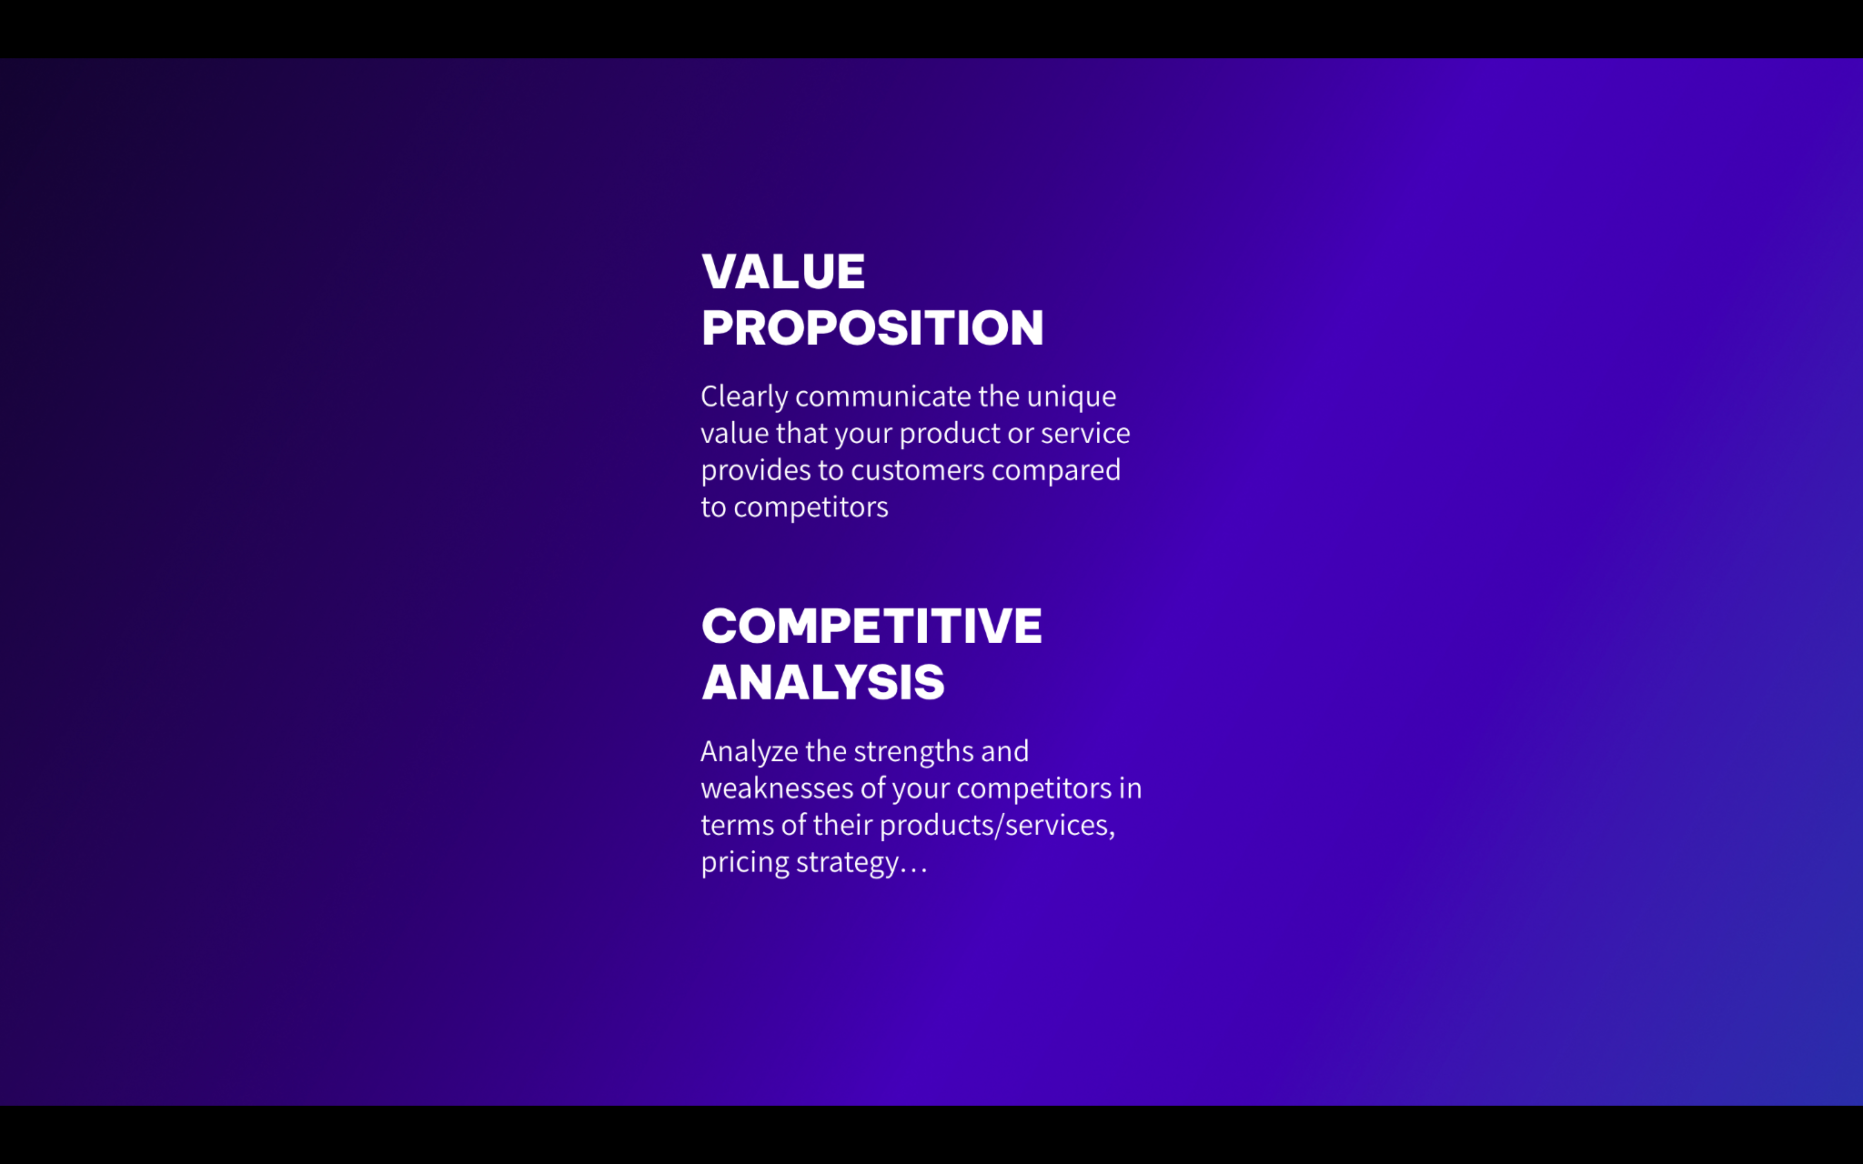
MOCKUP
A mockup provides a visual representation of your product or service, allowing investors or stakeholders to better understand what you're offering and how it works

Slide 18
CANVAS INFOGRAPHIC
KEY PARTNERS | KEY ACTIVITIES | VALUE PROPOSITIONS |  | CUSTOMER RELATIONSHIPS | CUSTOMER SEGMENTS
Identify important partners for your business | Identify key activities that create value for customers | Define what sets your business apart from competitors |  | Determine how you will interact with customers | Define specific target customer groups
 | KEY RESOURCES |  |  | CHANNELS
 | Identify important resources needed for your business |  |  | Determine how you will reach and engage with customers
COST STRUCTURE |  |  | REVENUE STREAMS
Identify fixed and variable costs associated with the business |  |  | Define sources of revenue for your business

Slide 19
MY BUSINESS STRATEGY
Attractive business model
GROWTH AND EXPANSION STRATEGY
REORIENTATION OR ABANDONMENT STRATEGY
High competitive strength
Low competitive strength
MAINTENANCE AND PROTECTION STRATEGY
REDUCTION OR ELIMINATION STRATEGY
Unattractive business model

Slide 20
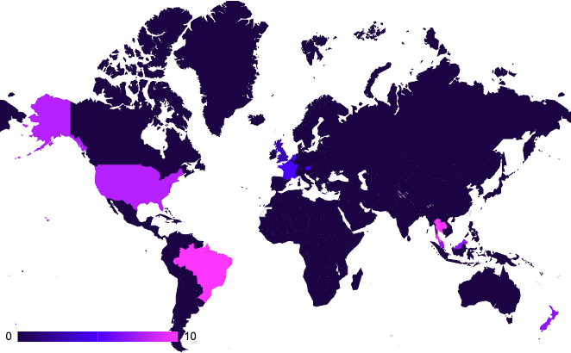
TARGET INFOGRAPHIC
DEMOGRAPHIC
LOCATIONS
BEHAVIOR
AGE
25-50 years old
They may be interested in personal and professional development, as they are employees and students.
They may be tech-savvy and use technology to streamline their work and personal life
GENDER
Male and female
OCCUPATION
Employees
and students
25%
75%
FAMILY SITUATION
Single and married people
REGION
Various
INCOME
$50,000/year
AREA
Urban
PASSIVE BUYERS
ACTIVE BUYERS
Follow the link in the map to modify its data and then paste the new one here. For more info, click here

Slide 21
ORGANIZATIONAL CHART
DIRECTOR OF HR
SYSTEM ADMINISTRATOR
CTO
DIRECTOR OF IT
IT MANAGER
CEO
ACCOUNTING MANAGER
CONTROLLER
FINANCIAL ANALYST
CFO
TREASURER
ACCOUNTS PAYABLE

Slide 22
MARKET SIZE INFOGRAPHIC
$100 M
$100 M
"With the innovative approach and unique features, we aim to capture a significant portion of the $100 million"
$20 M
$20 M
"The research indicates that the market for [product/service] is projected to reach $20 million by next year"
$5 M
$5 M
"The market for [product/service] is currently valued at $5 million"

Slide 23
THANKS!
Do you have any questions?
youremail@freepik.com
+34 654 321 432
yourwebsite.com
Please keep this slide for attribution

Slide 24
ALTERNATIVE RESOURCES
Here’s an assortment of alternative resources whose style fits that of this template:
Vectors:
Business card design template

Slide 25
RESOURCES
Did you like the resources used in this template? Get them on these websites:
Vectors:
Sale poster design template
Photos:
Industrial designers working on 3d model

Slide 26
Instructions for use
If you have a free account, in order to use this template, you must credit Slidesgo by keeping the Thanks slide. Please refer to the next slide to read the instructions for premium users.
As a Free user, you are allowed to:
Modify this template.
Use it for both personal and commercial projects.
You are not allowed to:
Sublicense, sell or rent any of Slidesgo Content (or a modified version of Slidesgo Content).
Distribute Slidesgo Content unless it has been expressly authorized by Slidesgo.
Include Slidesgo Content in an online or offline database or file.
Offer Slidesgo templates (or modified versions of Slidesgo templates) for download.
Acquire the copyright of Slidesgo Content.
For more information about editing slides, please read our FAQs or visit our blog:
https://slidesgo.com/faqs and https://slidesgo.com/slidesgo-school

Slide 27
Instructions for use (premium users)
As a Premium user, you can use this template without attributing Slidesgo or keeping the "Thanks" slide.
You are allowed to:
Modify this template.
Use it for both personal and commercial purposes.
Hide or delete the “Thanks” slide and the mention to Slidesgo in the credits.
Share this template in an editable format with people who are not part of your team.
You are not allowed to:
Sublicense, sell or rent this Slidesgo Template (or a modified version of this Slidesgo Template).
Distribute this Slidesgo Template (or a modified version of this Slidesgo Template) or include it in a database or in any other product or service that offers downloadable images, icons or presentations that may be subject to distribution or resale.
Use any of the elements that are part of this Slidesgo Template in an isolated and separated way from this Template.
Register any of the elements that are part of this template as a trademark or logo, or register it as a work in an intellectual property registry or similar.
For more information about editing slides, please read our FAQs or visit our blog:
https://slidesgo.com/faqs and https://slidesgo.com/slidesgo-school

Slide 28
Fonts & colors used
This presentation has been made using the following fonts:
Be Vietnam Pro
(https://fonts.google.com/specimen/Be+Vietnam+Pro)
Assistant
(https://fonts.google.com/specimen/Assistant)
#ffffff
#1b0344
#3c0cb0
#4b01ff
#ff36ff

Slide 29





Storyset
Create your Story with our illustrated concepts. Choose the style you like the most, edit its colors, pick the background and layers you want to show and bring them to life with the animator panel! It will boost your presentation. Check out how it works.
Pana
Amico
Bro
Rafiki
Cuate

Slide 30
Use our editable graphic resources...
You can easily resize these resources without losing quality. To change the color, just ungroup the resource and click on the object you want to change. Then, click on the paint bucket and select the color you want. Group the resource again when you’re done. You can also look for more infographics on Slidesgo.

Slide 33
JANUARY
FEBRUARY
MARCH
APRIL
MAY
JUNE
PHASE 1
Task 1
Task 2
PHASE 2
Task 1
Task 2
JANUARY
FEBRUARY
MARCH
APRIL
PHASE 1
Task 1
Task 2

Slide 36
...and our sets of editable icons
You can resize these icons without losing quality.
You can change the stroke and fill color; just select the icon and click on the paint bucket/pen.
In Google Slides, you can also use Flaticon’s extension, allowing you to customize and add even more icons.

Slide 37
Educational Icons
Medical Icons

Slide 38
Business Icons
Teamwork Icons

Slide 39
Help & Support Icons
Avatar Icons

Slide 40
Creative Process Icons
Performing Arts Icons

Slide 41
Nature Icons

Slide 42
SEO & Marketing Icons

Slide 43


